Slide 1
Lab 13 Mutex and Condition Variable
TA: Tzu-Han Chen
Professor: Hsung-Pin Chang
Operating System Lab

Slide 2
Outline
POSIX Mutex
Condition Variable

Slide 3
Mutex
A mutex has two states: locked and unlocked
At most one thread may hold the lock on a mutex
Attempting to lock a mutex that is already locked causes the process to block
Procedures
Lock the mutex for the shared resource
Access the shared resource
Unlock the mutex

Slide 4
Using a Mutex to protect a critical section
Thread A
Thread B
Lock mutex M
Lock mutex M
access shared
resource
blocks
Unlock mutex M
unblocks
access shared
resource
Unlock mutex M

Slide 5
Statically Allocated Mutexes
A mutex is a variable of the type pthread_mutex_t.
Before it can be used, a mutex must always be initialized as following
EX:
pthread_mutex_t mtx = PTHREAD_MUTEX_INITIALIZER;

Slide 6
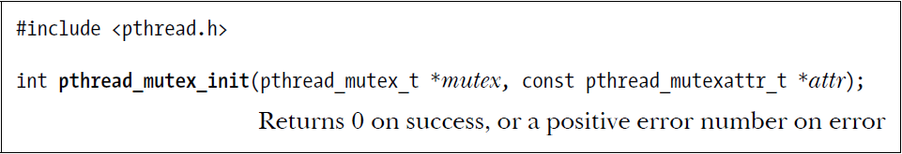
Dynamic Allocated Mutex
The static initializer value PTHREAD_MUTEX_INITIALIZER can be used only for initializing a statically allocated mutex with default attributes.
In all other cases, we must dynamically initialize the mutex using pthread_mutex_init().
EX:
int s;
pthread_mutex_t mtx;
s = pthread_mutex_init(&mtx,NULL);

Slide 7
Mutex Attribute Types
As shown above, the pthread_mutex_init() attr argument can be used to specify a pthread_mutexattr_t object that defines the attributes of a mutex.
If attr is specified as NULL, the mutex is assigned various default attributes.

Slide 8
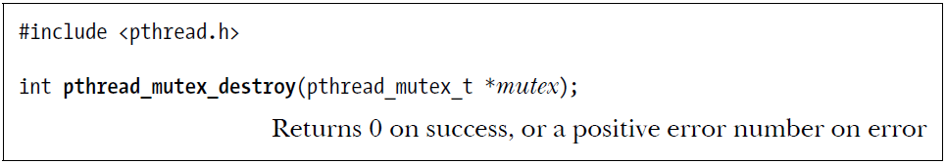
Destroy Mutex
When an automatically or dynamically allocated mutex is no longer required, it should be destroyed using pthread_mutex_destroy().

Slide 9
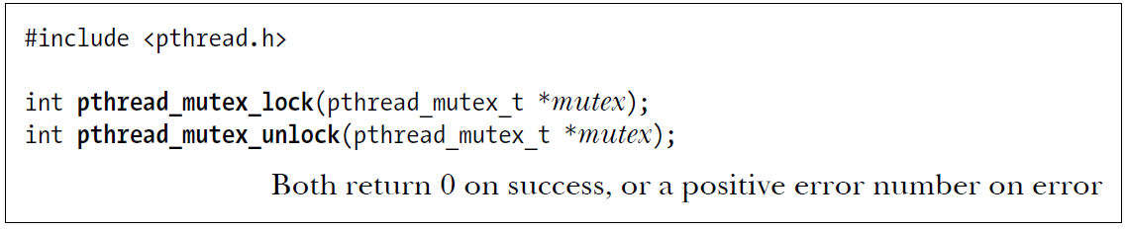
POSIX Mutex APIs-Locking and Unlocking a Mutex
pthread_mutex_lock()
If the mutex is currently unlocked
Locks the mutex and returns immediately
If the mutex is currently locked by another thread
Blocks until the mutex is unlocked
pthread_mutex_unlock()
Unlocks a mutex previously locked
Only the thread calling the pthread_mutex_unlock() can unlock the mutex

Slide 10
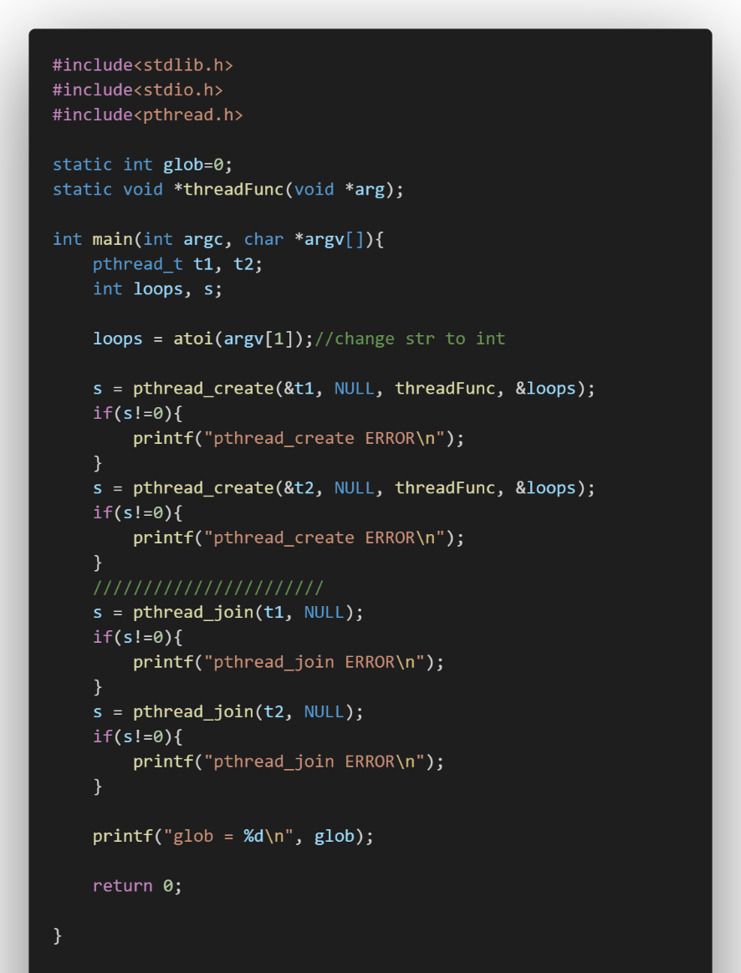
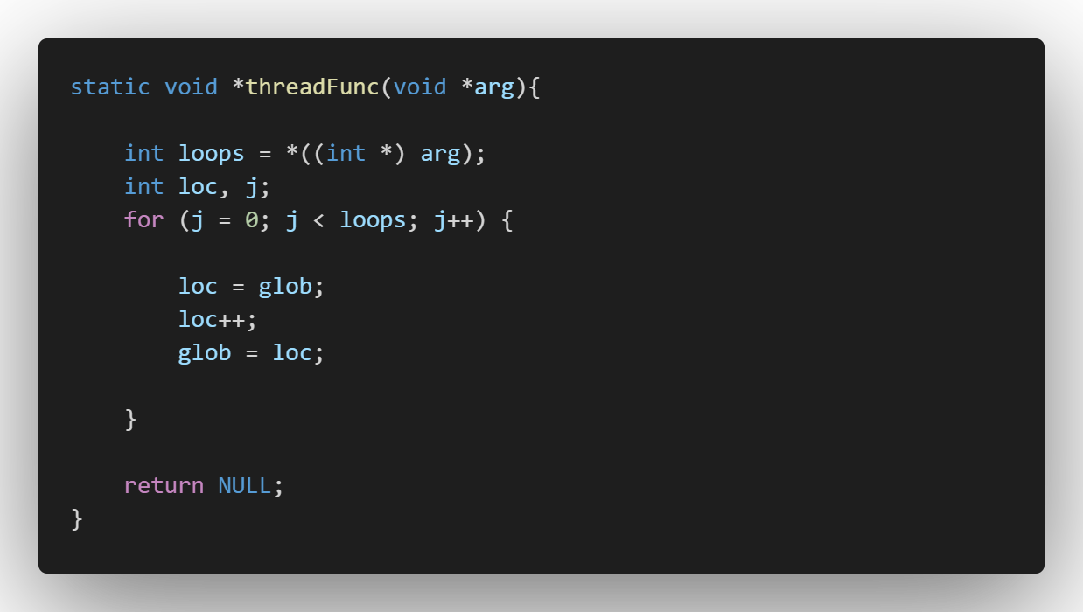
Example 1 showing Race Condition

Slide 11
Execution Result

Slide 12
Race Condition
Thread 1 | loc | Thread 2 | loc | glob
loc=glob | 0 | --- | --- | 0
loc++ | 1 | --- | --- | 0
--- | --- | loc=glob | 0 | 0
--- | --- | loc++ | 1 | 0
glob=loc | 1 | --- | --- | 1
--- | --- | glob=loc | 1 | 1
1
2
3
4
5
6
7
NCHU System & Network Lab

Slide 13
Race Condition
Thread 1 | loc | Thread 2 | loc | glob
loc=glob | 0 | --- | --- | 0
loc++ | 1 | --- | --- | 0
--- | --- | loc=glob | 0 | 0
--- | --- | loc++ | 1 | 0
glob=loc | 1 | --- | --- | 1
--- | --- | glob=loc | 1 | 2
1
2
3
4
5
6
7
NCHU System & Network Lab

Slide 14
Race Condition
Thread 1 | loc | Thread 2 | loc | glob
loc=glob | 0 | --- | --- | 0
loc++ | 1 | --- | --- | 0
--- | --- | loc=glob | 0 | 0
--- | --- | loc++ | 1 | 0
glob=loc | 1 | --- | --- | 1
--- | --- | glob=loc | 1 | 2
1
2
3
4
5
6
7
NCHU System & Network Lab

Slide 15
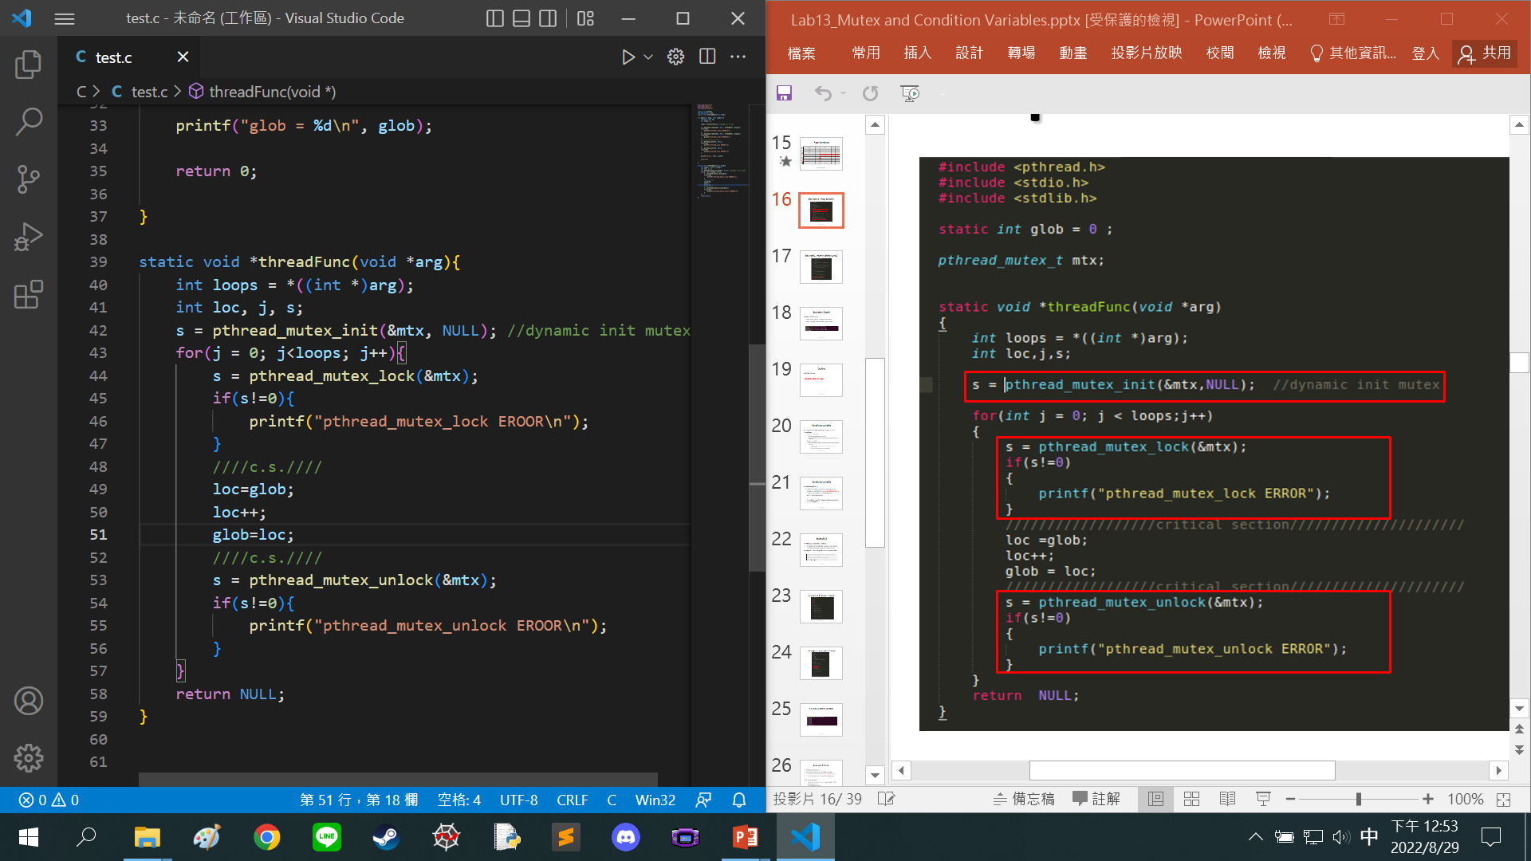
Example 1 : How to Solve

Slide 16
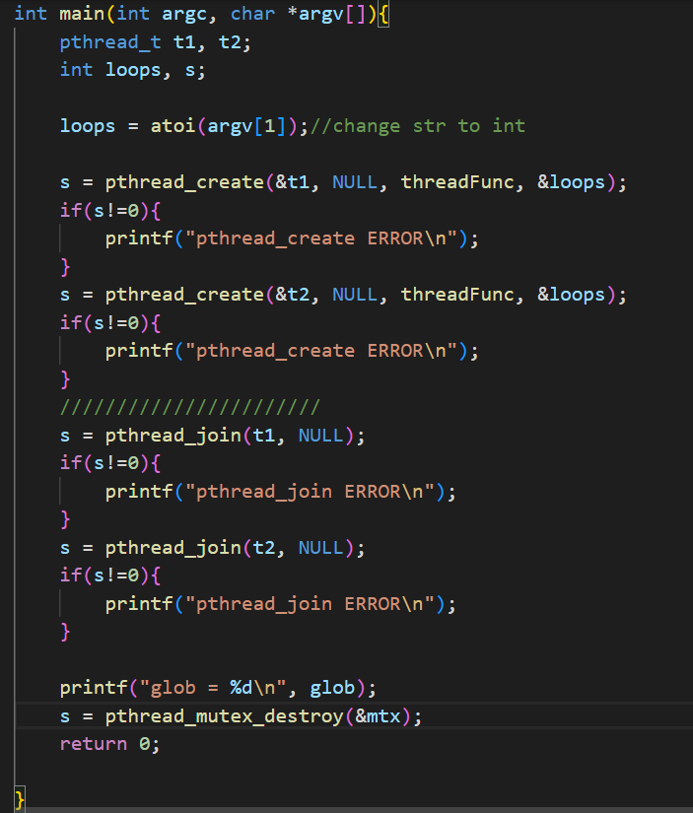
Example1 : How to Solve(cont.)

Slide 17
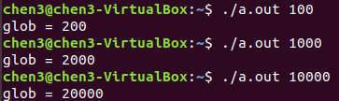
Execution Result
Execution Results
The glob is always reliably incremented
But, the execution time becomes longer

Slide 18
Outline
POSIX Mutex
POSIX Condition Variable

Slide 19
Condition Variable
Condition Variables: signaling changes of state
Overview
Mutex or semaphore:
Provide serialized access to a resource
Prevents multiple threads from accessing a shared variable at the same time
Condition variable
Allow one thread to notify some other thread that some event has occurred.
A thread informs other threads about changes in the state of a shared resource
Other threads wait (block) for such notification

Slide 20
Condition Variable
Overview (Cont.)
Without condition variables, the programmer would need to have threads continually polling to check if the condition is satisfied or not.
very resource consuming
A condition variable is always used in conjunction with a mutex lock

Slide 21
Example 2
Producer-Consumer Problem
A number of threads that produce some “items” that are consumed by the consumer thread
Version 1: not using the condition variables
//represent the number of produced units awaiting consumption
static int avail = 0;
// declared a mutex to protect the “avail” variable
pthread_mutex_t mtx;

Slide 22
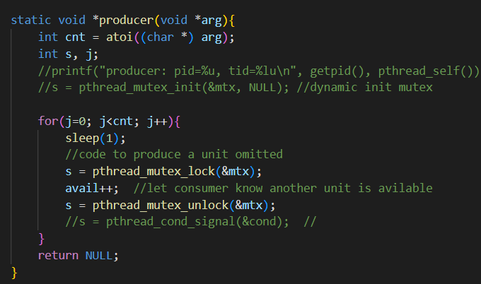
Example 2: Producer Thread

Slide 23
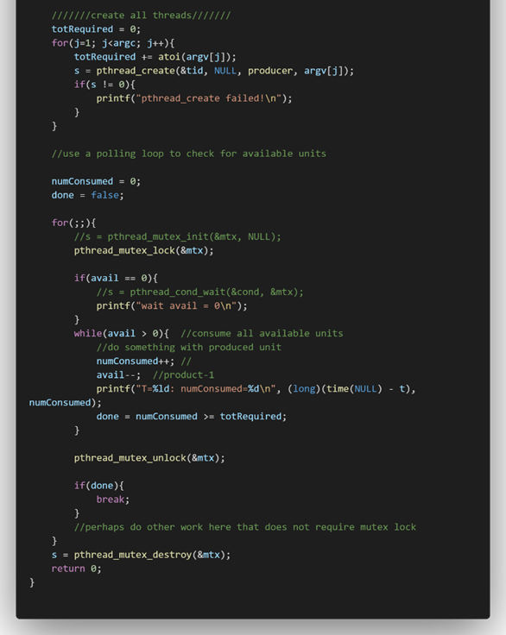

Example 2: Consumer Thread

Slide 24
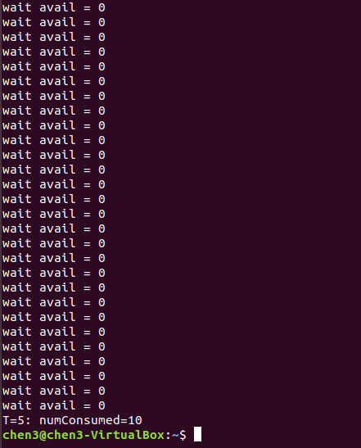
No Using Condition Variables

Slide 25
Example 2 (Cont.)
Problem of Example 2
The above code works, but it wastes CPU time
Since the consumer thread continually loops (busy waiting), checking the state of the variable avail.
A better solution
Allows the consumer thread to sleep (wait) until the variable avail > 0
Sol. condition variable

Slide 26
Statically Allocated Conditional Variable
A condition variable has the type pthread_cond_t.
As with a mutex, a condition variable must be initialized before use.
EX:
pthread_cond_t cond = PTHREAD_COND_INITIALIZER;

Slide 27
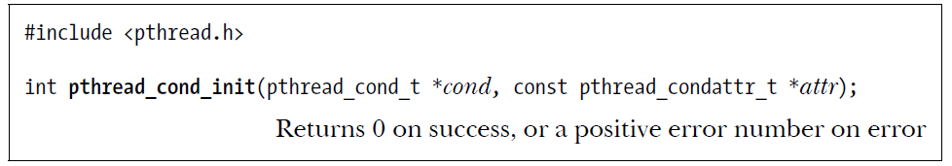
Dynamic Allocated Conditional Variable
The pthread_cond_init() function is used to dynamically initialize a condition variable .
If attr is NULL, a default set of attributes is assigned to the condition variable.
EX:
int s ;
pthread_cond_t cond;
s = pthread_cond_init(&cond,NULL);

Slide 28
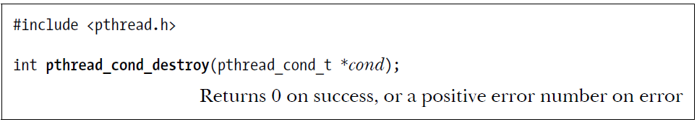
Destroy Conditional Variable
When an automatically or dynamically allocated condition variable is no longer required, then it should be destroyed using pthread_cond_destroy().

Slide 29
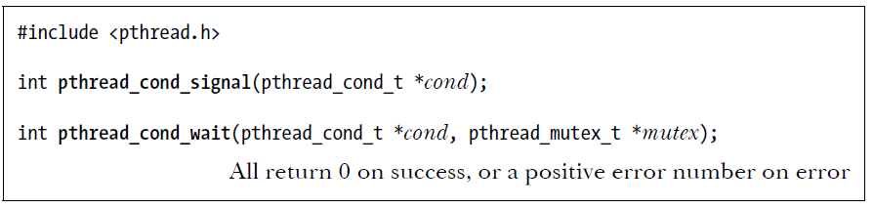
Signal a Conditional Variable
Process can signal and wait on condition variables
pthread_cond_signal()
Signal the condition variable specified by cond.
A condition variable holds no state information

Slide 30
Wait on a Conditional Variable
pthread_cond_wait()
Blocks a thread until the condition variable cond is signaled
A condition variable always has an associated mutex
Both of these objects are passed as arguments to pthread_cond_wait()
Performs the following steps
Unlock the mutex specified by mutex
Block the calling thread until another thread signals the condition variable cond
Relock mutex, after signal is received

Slide 31
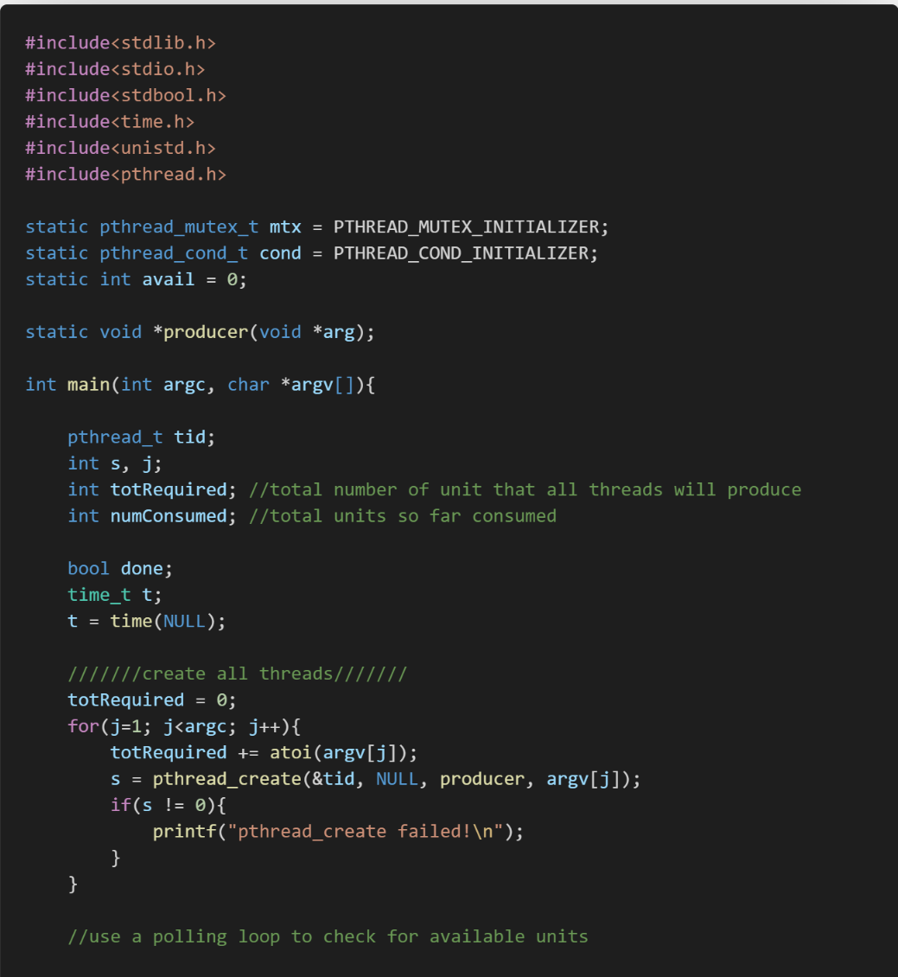
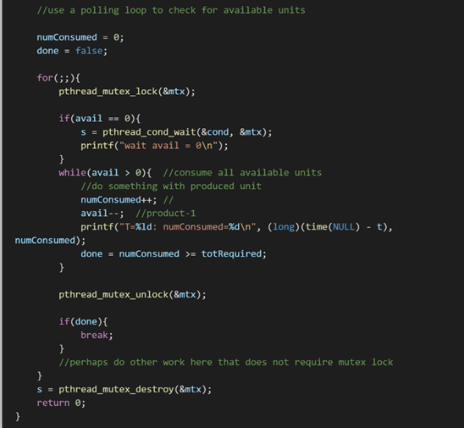
Example 2 - Version 2 by Using Condition Variable

Slide 32
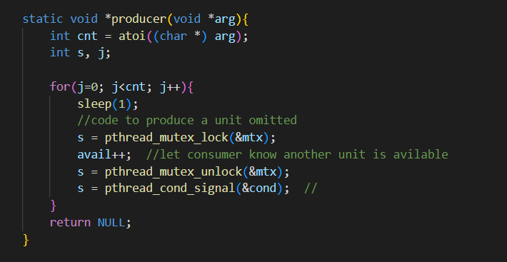
Example 2 - Version 2 by Using Condition Variable

Slide 33
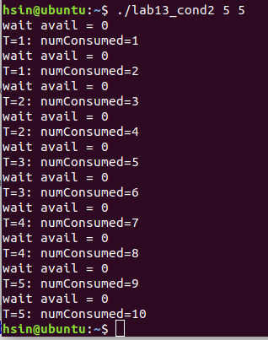
Execution Results

Slide 34
Exercises 1
We have three threads to run two different functions to access a same global variable.
Function 1: Addition +2
Function 2: subtraction -2
Two thread execute Function 1 , one thread execute Function 2.
Each function execute 1000000 times.
( Hint: User can change times -> ./ex1 1000000 )
Show the result and check the result is correct or not.
Ex: the result is 2000000 if 1000000 times

Slide 35
Exercises 1 Execution Result

Slide 36
Exercises 2
Print 1 3 5 infinitely using threads.
Create three threads T1, T2, and T3 such that those should print 1 3 5 sequence infinitely by using condition variable)
(Hint1: Use three condition variable.)
(Hint2:change a glob variable value then print it.)
Output: 1 3 5 1 3 5 1 3 5 1 3 5 ………..(loop)

Slide 37
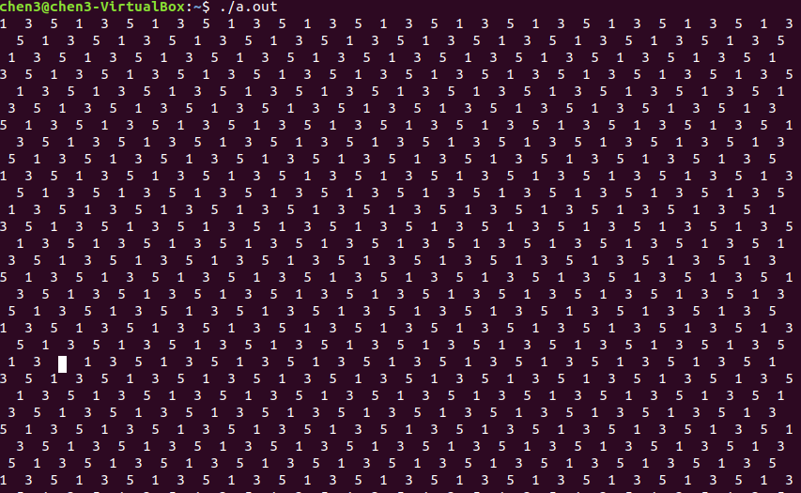
Exercises 2 Execution Result

Slide 38
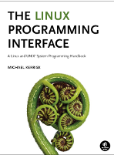
References
Michael Kerrisk, “The Linux Programming Interface: A Linux and UNIX System Programming Handbook,” Chapters 30 and 53.
The Linux Programming Interface.
http://man7.org/tlpi/code/online/dist/threads/prod_condvar.c.html
Synchronizing Threads with POSIX Semaphores
http://www.csc.villanova.edu/~mdamian/threads/posixsem.html
https://www.geeksforgeeks.org/print-1-2-3-infinitely-using-threads-in-c/

